Slide 1







The homogenization of GPS Integrated Water Vapour time series: methodology and benchmarking the algorithms on synthetic datasets
R. Van Malderen¹, E. Pottiaux², A. Klos³, O. Bock⁴, J. Bogusz³, B. Chimani⁵, M. Elias⁶, M. Gruszczynska³, J. Guijarro⁷, S. Zengin Kazancı⁸ and T. Ning⁹
1
2
3
4
5
6
7
8
9
Royal Observatory
of Belgium

Slide 2
Outline
Motivation and introduction
Methodology
Synthetic dataset generation
Assessment of the performance of the homogenization tools on the synthetic dataset
Outlook

Slide 3

Motivation & introduction
Methodology
Synthetic datasets
Performance of homogen tools
Outlook
Motivation
COST action GNSS4SWEC ‘Advanced Global Navigation Satellite Systems tropospheric products for monitoring severe weather events and climate’
WG3: Use of GNSS tropospheric products for climate monitoring (e.g. Integrated Water Vapour (IWV) = Precipitable Water (PW))
From different presentations at different GNSS4SWEC workshops, it turned out that different groups were showing results from time series analyses, sometimes based on the same datasets.
They were dealing/struggling with the homogenization of their datasets.
➔ common activity, on a reference IWV dataset.

Slide 4
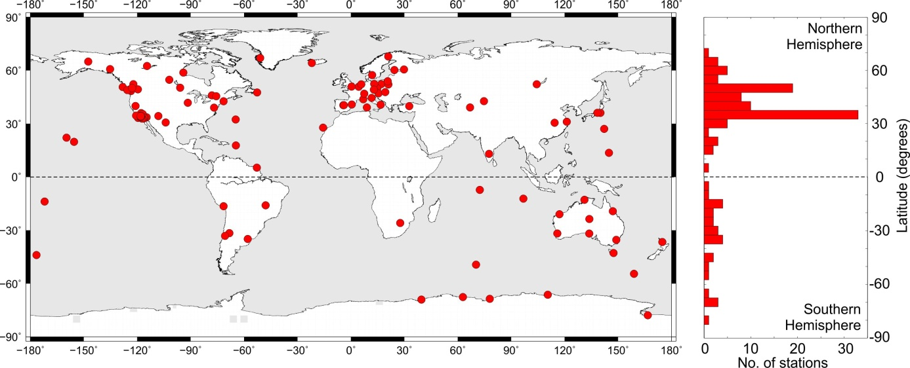

Motivation & introduction
Methodology
Synthetic datasets
Performance of homogen tools
Outlook
Introduction: the reference IWV dataset
From A. Klos
120 sites worldwide, with homogeneous reprocessing from 1995 – 2010
IGS repro 1: International GNSS Service, first reprocessing
screened, outlier removed, and ZTD converted to IWV by O. Bock

Slide 5
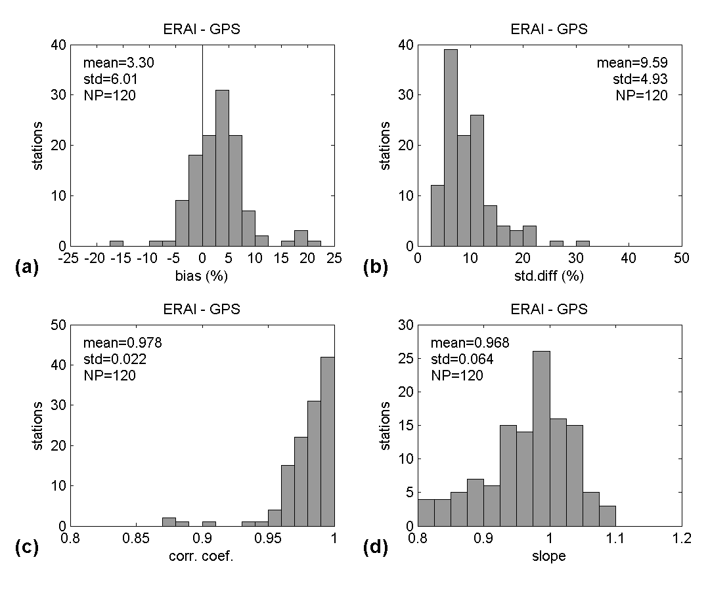
Motivation & introduction
Methodology
Synthetic datasets
Performance of homogen tools
Outlook
Methodology: use of a reference IWV dataset (ERA-interim)
good correlation between IGS repro 1 and ERA-interim model output
but: not fully independent datasets
  ERA-interim is used to screen the GPS data.
  ERA-interim is used to convert the Zenith Total Delay from GPS to IWV (surface pressure, weighted mean temperature).
ERA-interim not homogenous either!
From O. Bock
Notes:
ERA-interim: 79km horizontal resolution

Slide 6
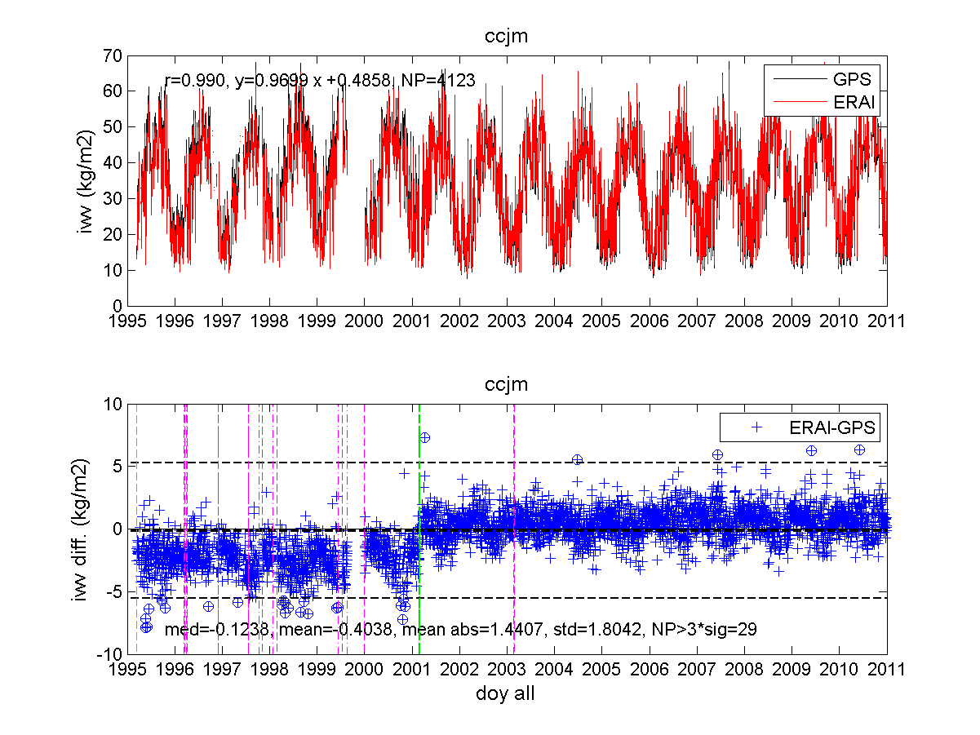
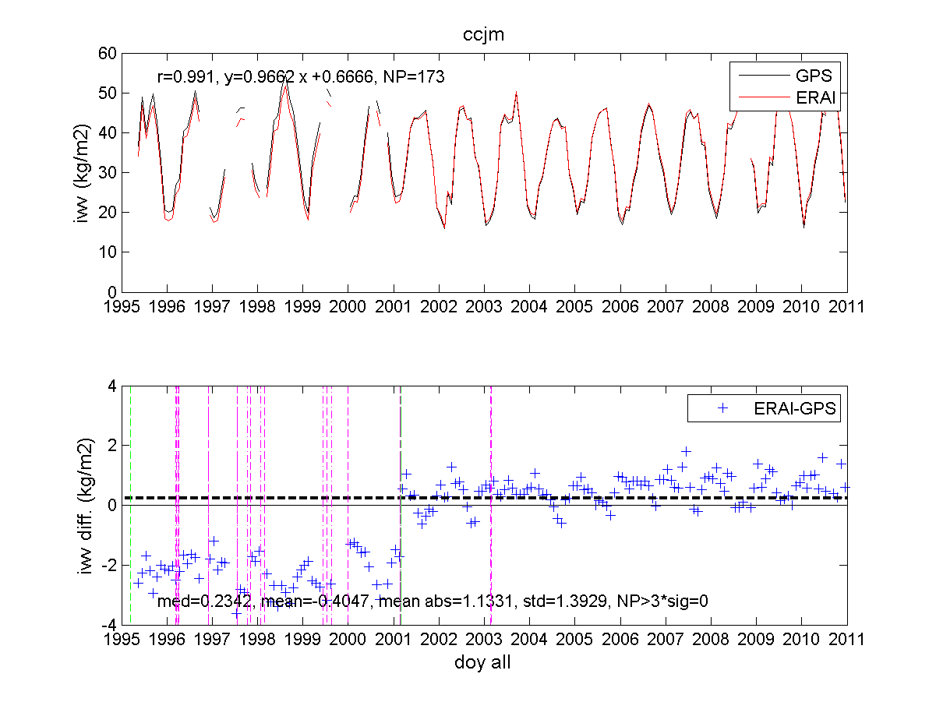
Motivation & introduction
Methodology
Synthetic datasets
Performance of homogen tools
Outlook
Methodology: use of a reference IWV dataset (ERA-interim)
daily
monthly
From O. Bock
We will look for break points/change points in the GPS – ERA-interim IWV differences series.

Slide 7
Motivation & introduction
Methodology
Synthetic datasets
Performance of homogen tools
Outlook
Generation of synthetic dataset: how?
based on the comparison of the epochs identified by different tools , we decided to build synthetic datasets with known inserted offsets for
  the assessment of the performance of the different tools
  a sensitivity analysis of this performance on the properties of the datasets
synthetic datasets of the IWV differences,
1. based on the characteristics of the real GPS – ERA-interim IWV differences:
  analysis of significant frequencies
  noise model
  linear trends
  gaps
2. based on the characteristics of the offsets in the real IWV differences:
  number
  typical amplitudes
computations were performed with Maximum Likelihood Estimation (MLE) in the Hector software (Bos et al., 2013).
around 1000 epochs of instrumental changes, reported in the stations metadata, were manually checked in the IWV differences (164 confirmed + 57 new ones) → also used for 1st order correction of the data

Slide 8
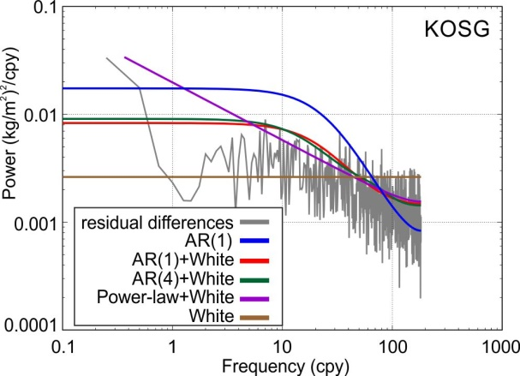
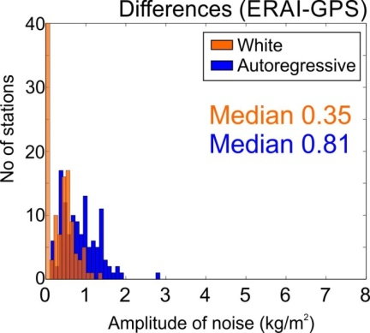
Motivation & introduction
Methodology
Synthetic datasets
Performance of homogen tools
Outlook
Noise model
combination of autoregressive process of first order plus white noise (AR(1)+WN) characterized by: coefficient, fraction and amplitude (AR), amplitude (WN).

Slide 9
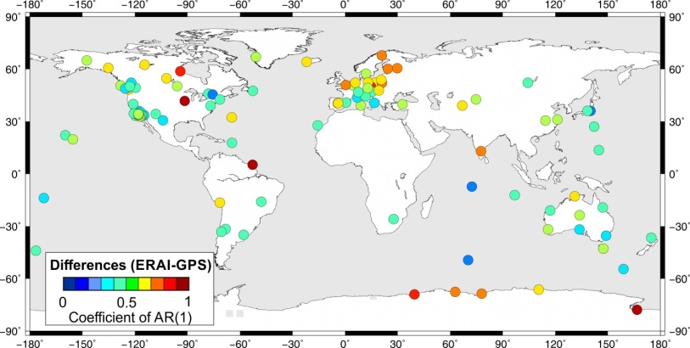
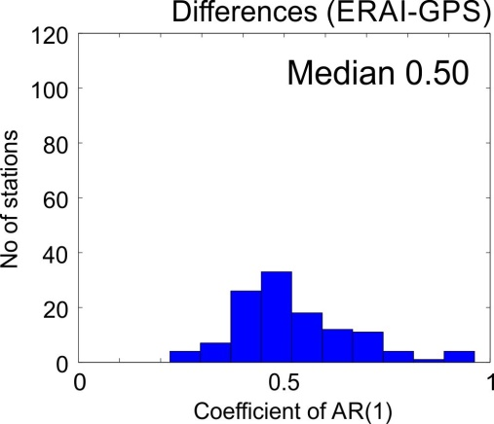
Motivation & introduction
Methodology
Synthetic datasets
Performance of homogen tools
Outlook
Noise model
combination of autoregressive process of first order plus white noise (AR(1)+WN) characterized by: coefficient, fraction and amplitude (AR), amplitude (WN).

Slide 10
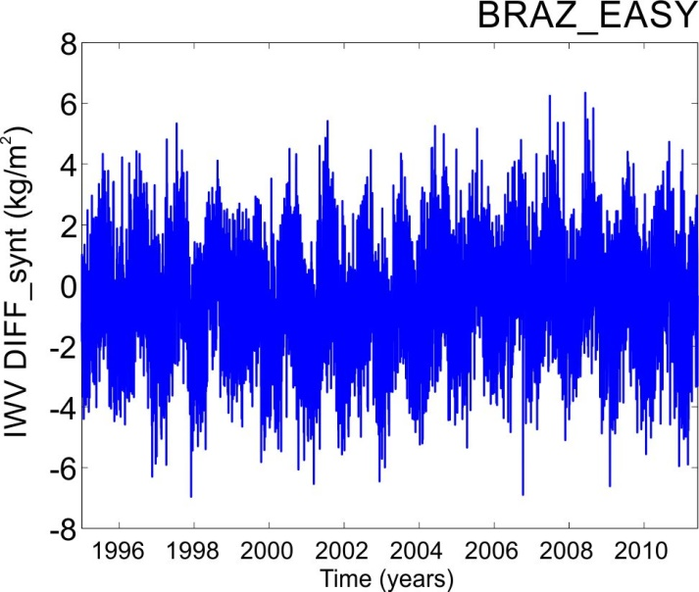
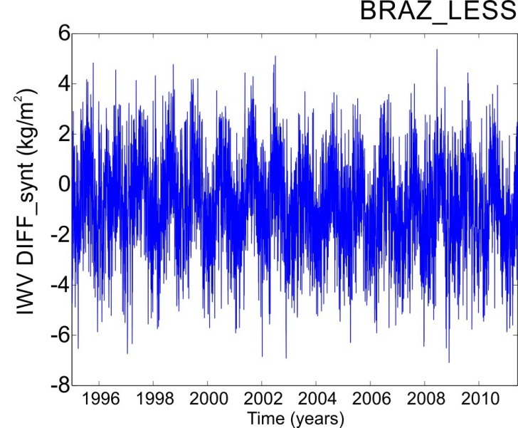
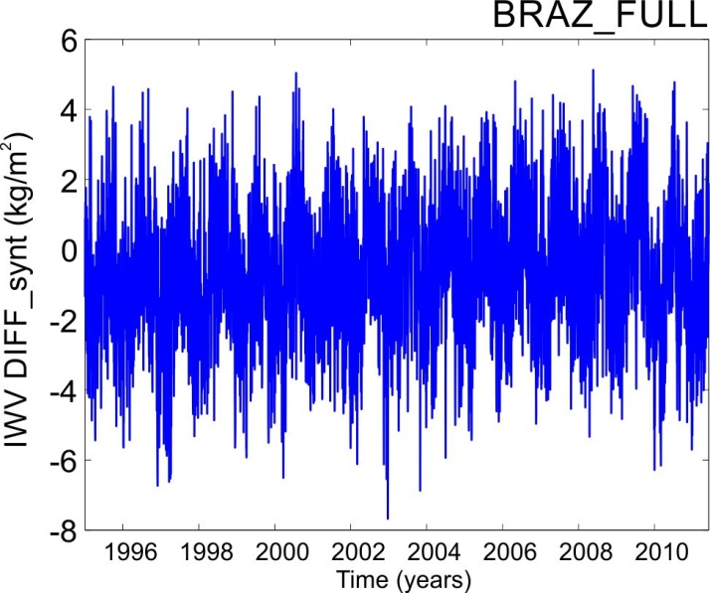
Motivation & introduction
Methodology
Synthetic datasets
Performance of homogen tools
Outlook
3 variants of synthetic time series of IWV differences
For every station (120 stations!), 3 variants of synthetic time series were created:
‘easy’ dataset: seasonal signals (annual, semi-annual, ter- and quater-annual, if present for a particular station) + offsets + white noise (WN)
‘less-complicated’ dataset: same as 1. + autoregressive process of the first order (noise model = AR(1)+WN)
‘fully-complicated’ dataset: same as 2. + trend + gaps (up to 20% of missing data = overshoot!)

Slide 11
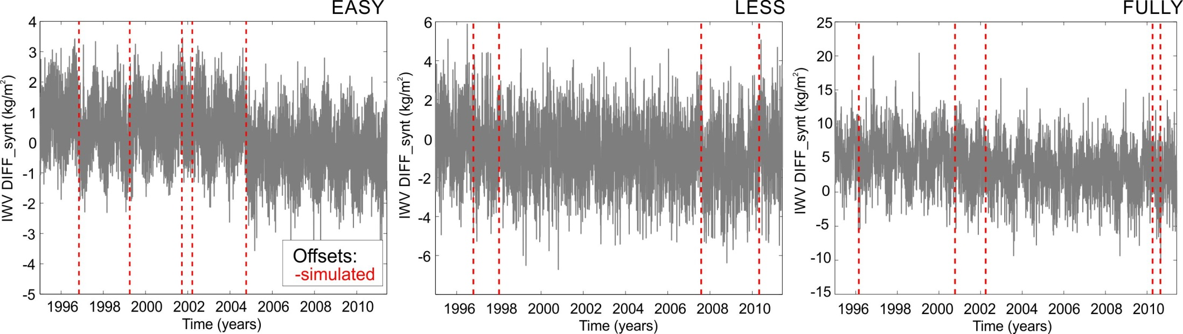
Motivation & introduction
Methodology
Synthetic datasets
Performance of homogen tools
Outlook
3 variants of synthetic time series of IWV differences
For every station (120 stations!), 3 variants of synthetic time series were created:
‘easy’ dataset: seasonal signals (annual, semi-annual, ter- and quater-annual, if present for a particular station) + offsets + white noise (WN)
‘less-complicated’ dataset: same as 1. + autoregressive process of the first order (noise model = AR(1)+WN)
‘fully-complicated’ dataset: same as 2. + trend + gaps (up to 20% of missing data)

Slide 12
Motivation & introduction
Methodology
Synthetic datasets
Performance of homogen tools
Outlook
Which homogenization tools?
Climatol
J. Guijarro
HOMOP
B. Chimani
PMTred
T. Ning
2-sample t-test
M. Elias
Pettitt test
S. Zengin Kazancı
Non-parametric tests
R. Van Malderen
 | Method 1 | Method 2 | Method 3 | Method 4 | Method 5 | Method 6 | Method 7
Operator | M. Elias | R. Van Malderen | R. Van Malderen | J. Guijarro | T. Ning | S. Zengin | B. Chimani
Method / SW | 2-sample t-test | 2 of 3 | PMW | CLIMATOL | PMTred | Pettitt | HOMOP
Daily/Monthly | D+M | D+M | D+M | D+M | D+M | D | X
Easy/Less/Full | E+L+F | E+L+F | E+L+F | L+F | E+L+F | E+L+F | E+F
Notes:
HOMOP: PRODIGE+SPLIDHOME
PMTred: a penalized maximal t test (PMT) to empirically construct a penalty function that evens out the U-shaped false-alarm distribution over the relative position in the time series being tested. PMTred accounts for first-order autoregressive noise.

Slide 13
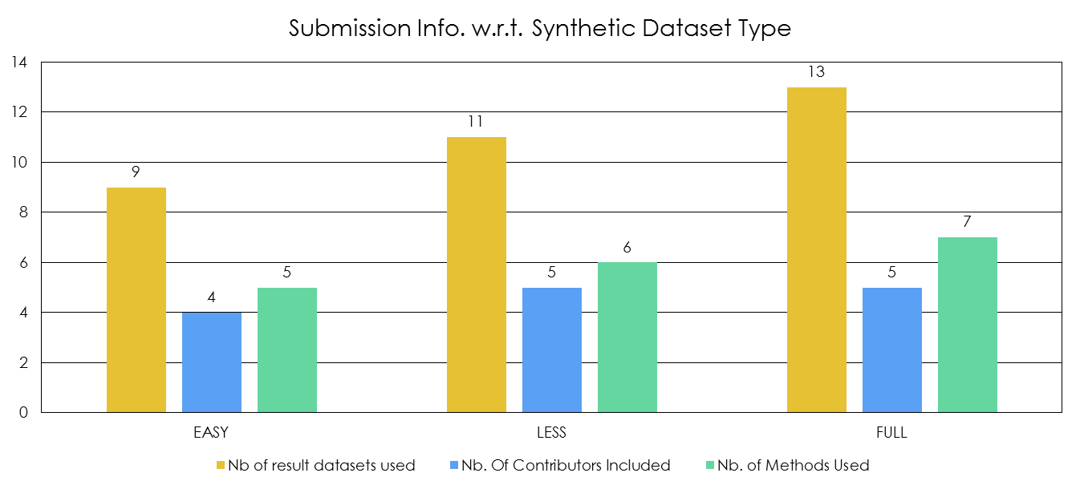
Motivation & introduction
Methodology
Synthetic datasets
Performance of homogen tools
Outlook
Which homogenization tools?

Slide 14
Motivation & introduction
Methodology
Synthetic datasets
Performance of homogen tools
Outlook
Assessment of the performance of tools on…
… the identification of the epochs of the inserted breakpoints (+ sensitivity analysis) in the synthetic datasets.
… the estimation of the trends that were or were not imposed to the 3 sets of synthetic IWV differences.
Venema et al. 2012, Benchmarking homogenization algorithms for monthly data, Climate of the Past, 8, 89-115, doi:10.5194/cp-8-89-2012.
Gazeaux et al. 2013, Detecting offsets in GPS time series: first results from the detection of offsets in GPS experiment, J. Geophys. Res. Solid Earth, 118, doi:10.1002/jgrb.50152.

Slide 15
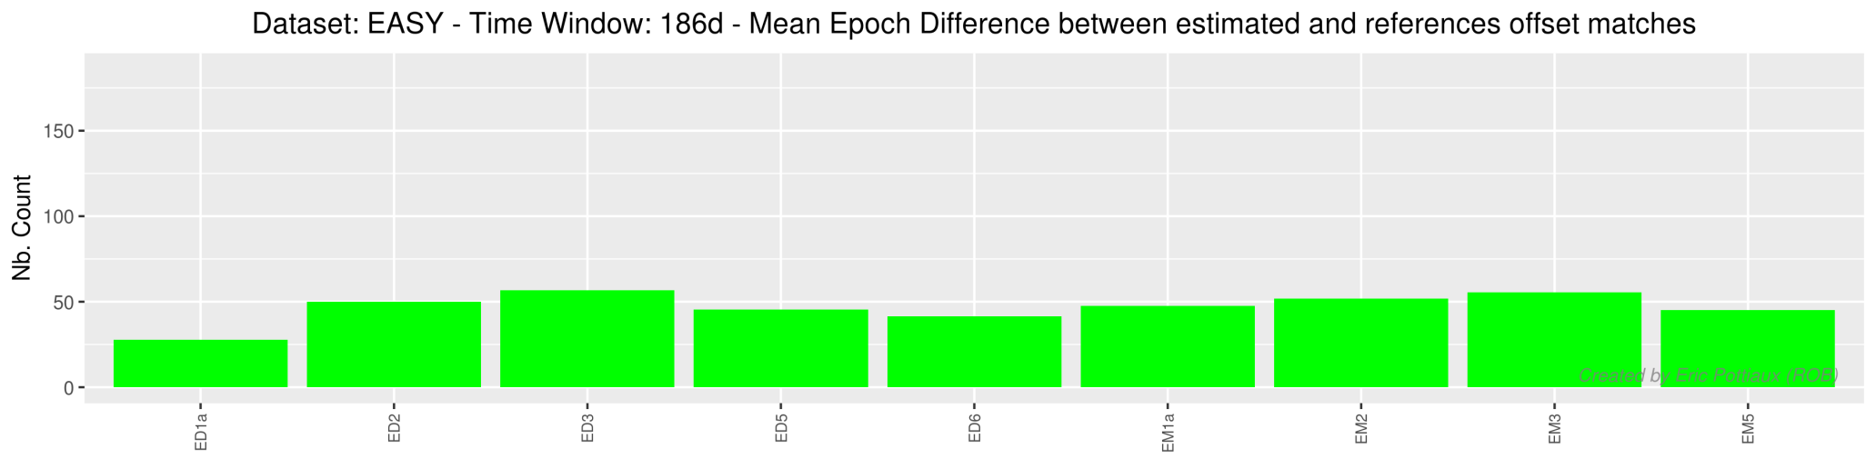
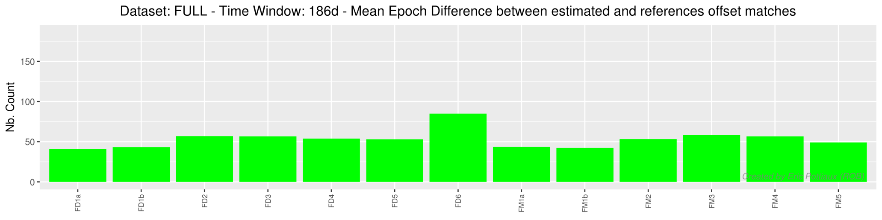
Motivation & introduction
Methodology
Synthetic datasets
Performance of homogen tools
Outlook
1. Identification of epochs of offsets: defining a proper time window
daily
monthly
Mean epoch difference
daily
monthly
Mean epoch difference
➔ In this presentation, a time window of 62d (2 months), will be assumed.

Slide 16
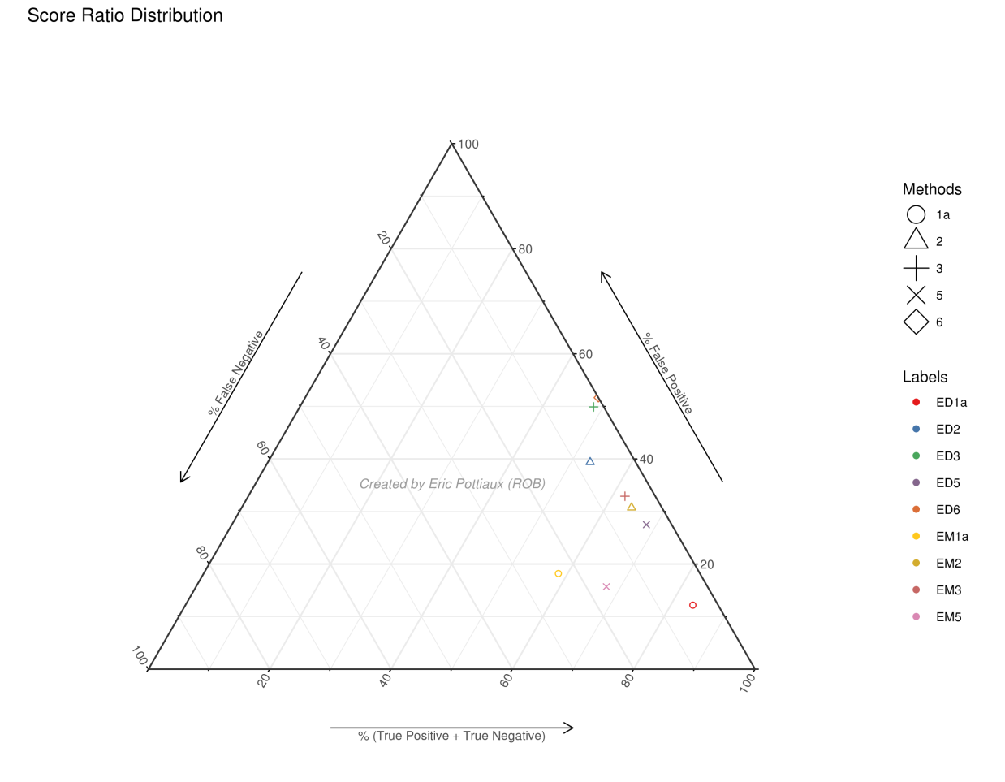
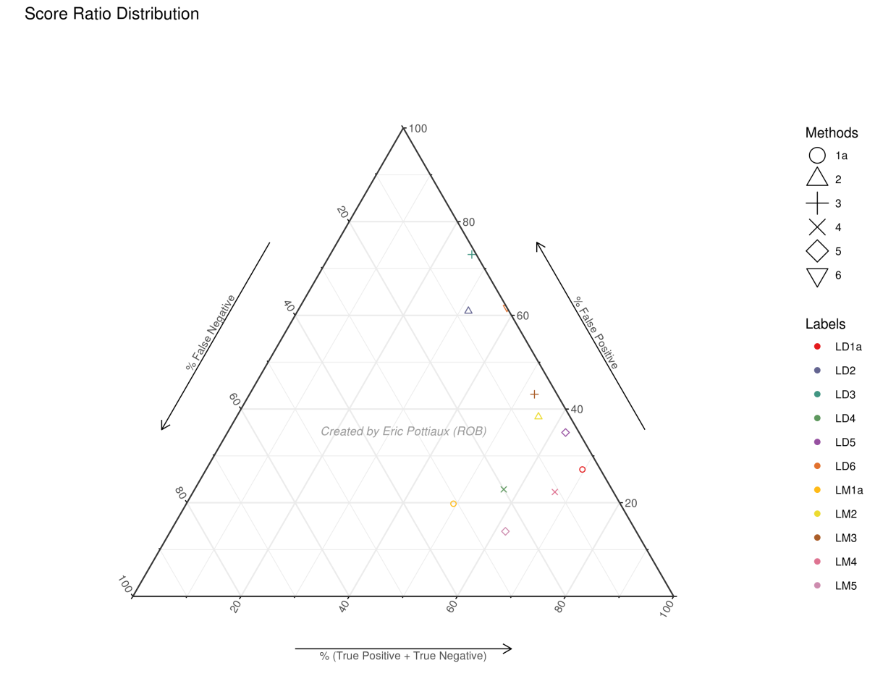
Motivation & introduction
Methodology
Synthetic datasets
Performance of homogen tools
Outlook
1. Identification of epochs of offsets: detection scores
EASY
+ A.R. Noise
LESS COMPLICATED
good performance
TP + TN > 40%
FP < 40%
FN < 40%
Performance Increase
Adapted from Gazeaux et al. 2013
Performance Increase
good performance for the majority of the tools for the easy and less complicated dataset

Slide 17
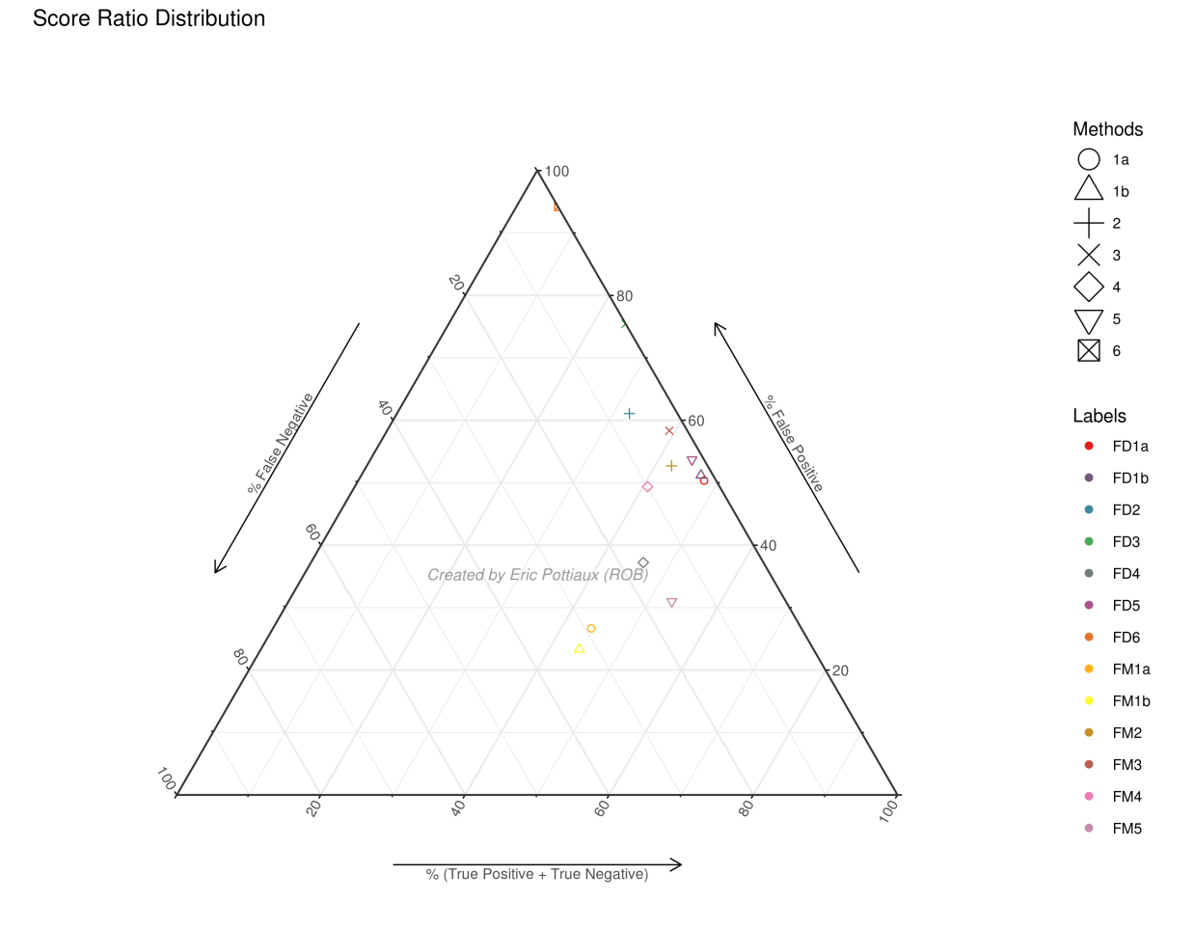
Motivation & introduction
Methodology
Synthetic datasets
Performance of homogen tools
Outlook
1. Identification of epochs of offsets: detection scores
LESS COMPLICATED
+ gaps and trend
FULLY COMPLICATED
Adapted from Gazeaux et al. 2013
performance decreases drastically for almost all the tools when adding gaps and a trend in the benchmark time series

Slide 18
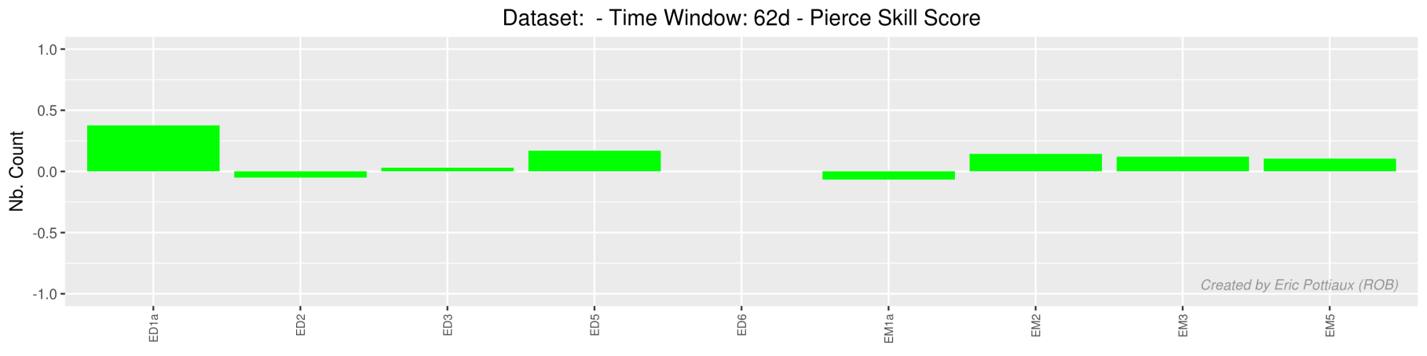
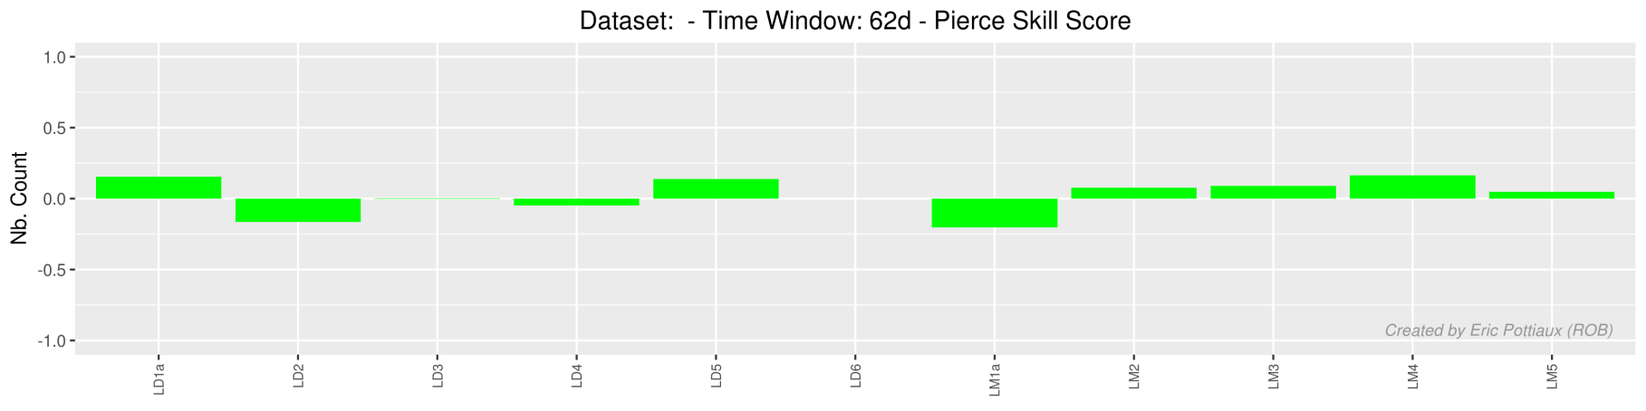
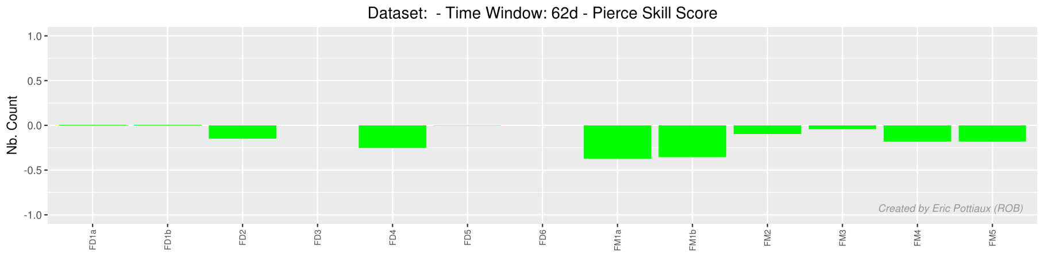
Motivation & introduction
Methodology
Synthetic datasets
Performance of homogen tools
Outlook
1. Identification of epochs of offsets: detection scores
= POD - POFD
EASY
PSS
LESS COMPLICATED
PSS
FULLY COMPLICATED
PSS
Venema et al. 2012
T: 0.10 → 0.63
Precip. : 0.04 → 0.22

Slide 19
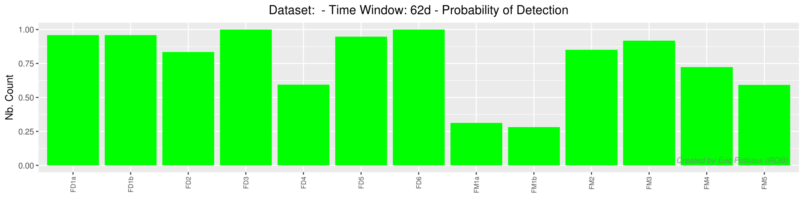
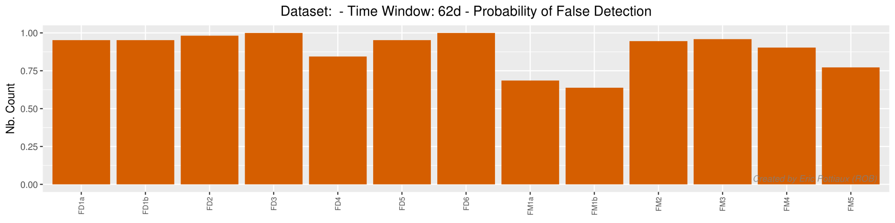
Motivation & introduction
Methodology
Synthetic datasets
Performance of homogen tools
Outlook
1. Identification of epochs of offsets: detection scores
FULLY COMPLICATED
POD
POFD

Slide 20
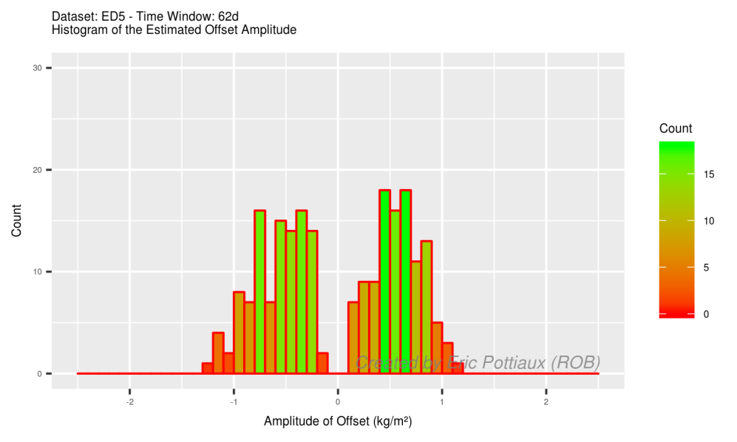
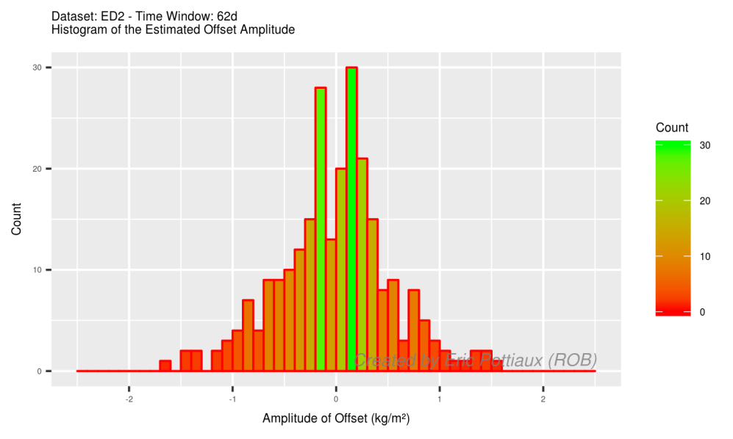
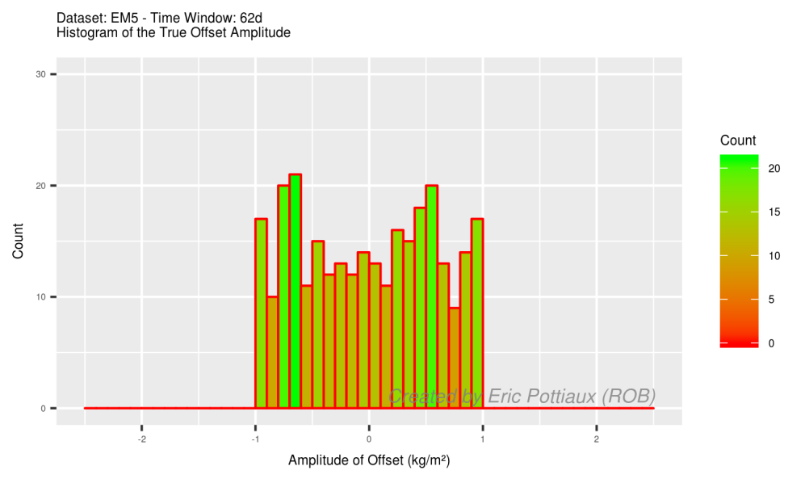

Motivation & introduction
Methodology
Synthetic datasets
Performance of homogen tools
Outlook
1. Identification of epochs of offsets: amplitudes of offsets
EASY
EASY
DAILY
←TRUTH →

Slide 21
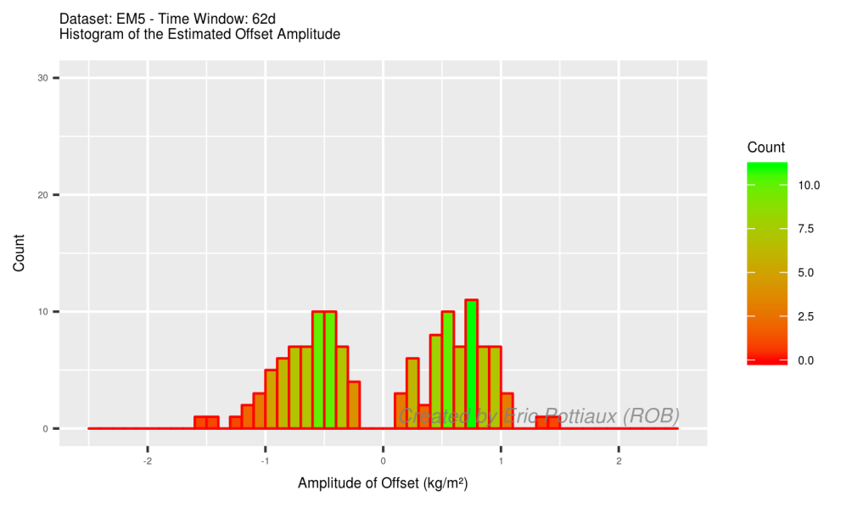
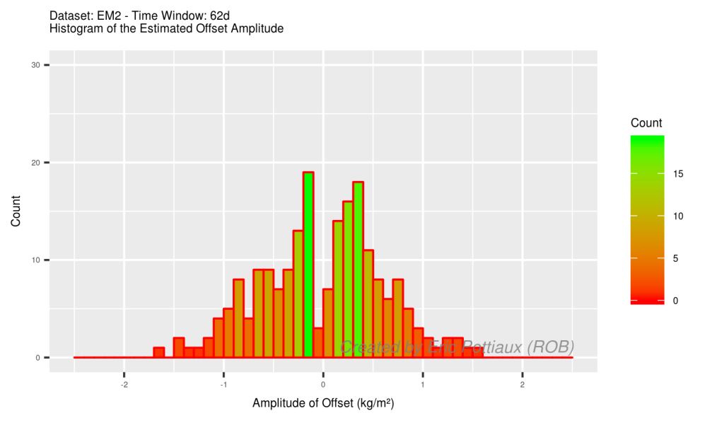
Motivation & introduction
Methodology
Synthetic datasets
Performance of homogen tools
Outlook
1. Identification of epochs of offsets: amplitudes of offsets
EASY
EASY
DAILY
MONTHLY

Slide 22
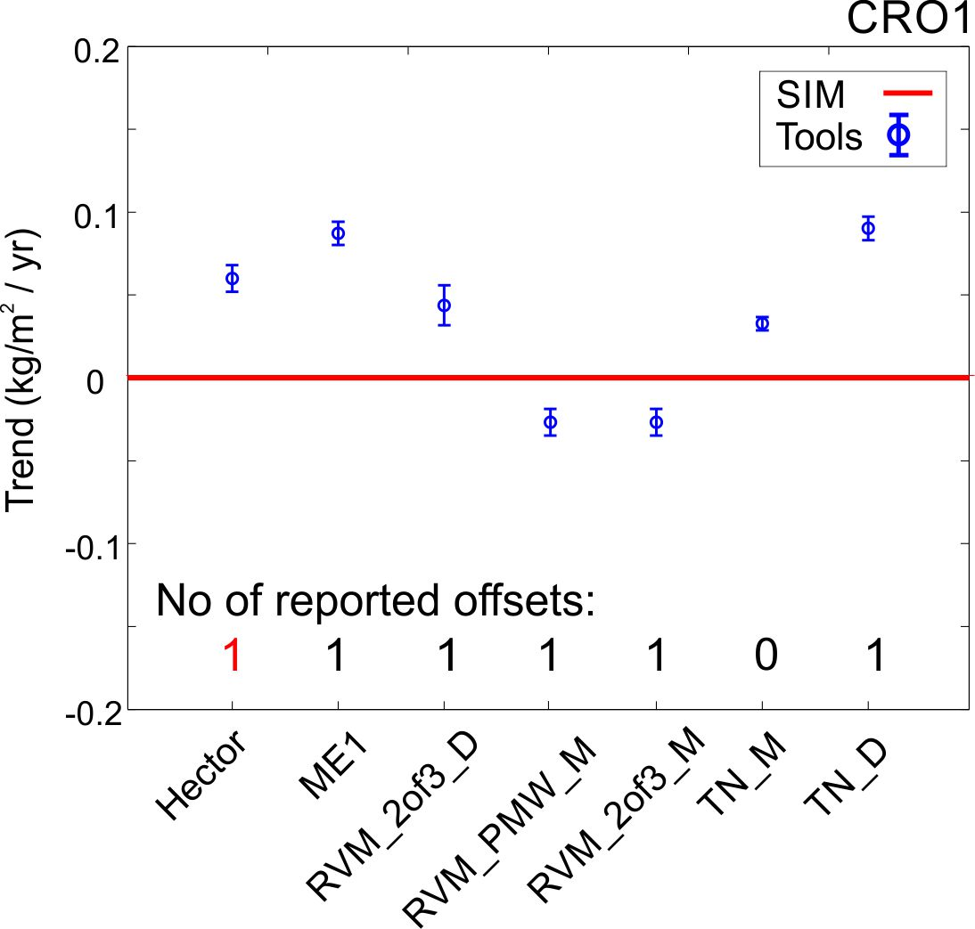
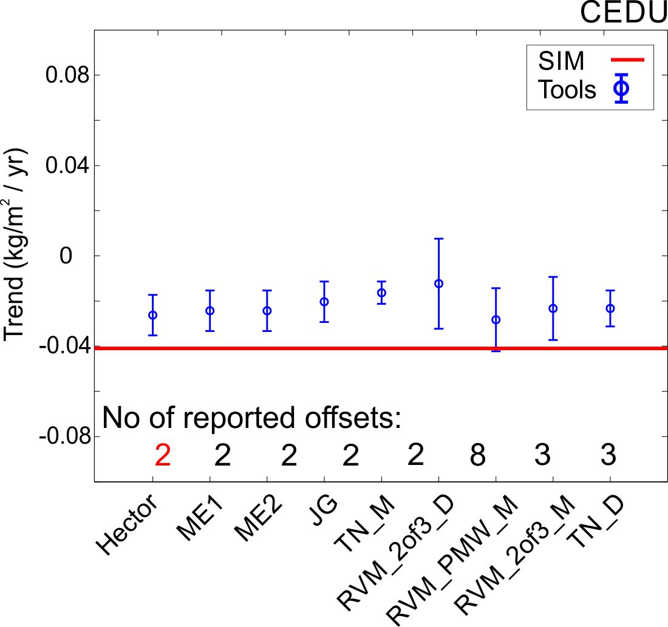
Motivation & introduction
Methodology
Synthetic datasets
Performance of homogen tools
Outlook
2. Trend estimation
EASY
FULLY COMPLICATED
“Hector “ = output from MLE with simulated offsets
large variety of trends (and uncertainties) for the different corrected time series

Slide 23
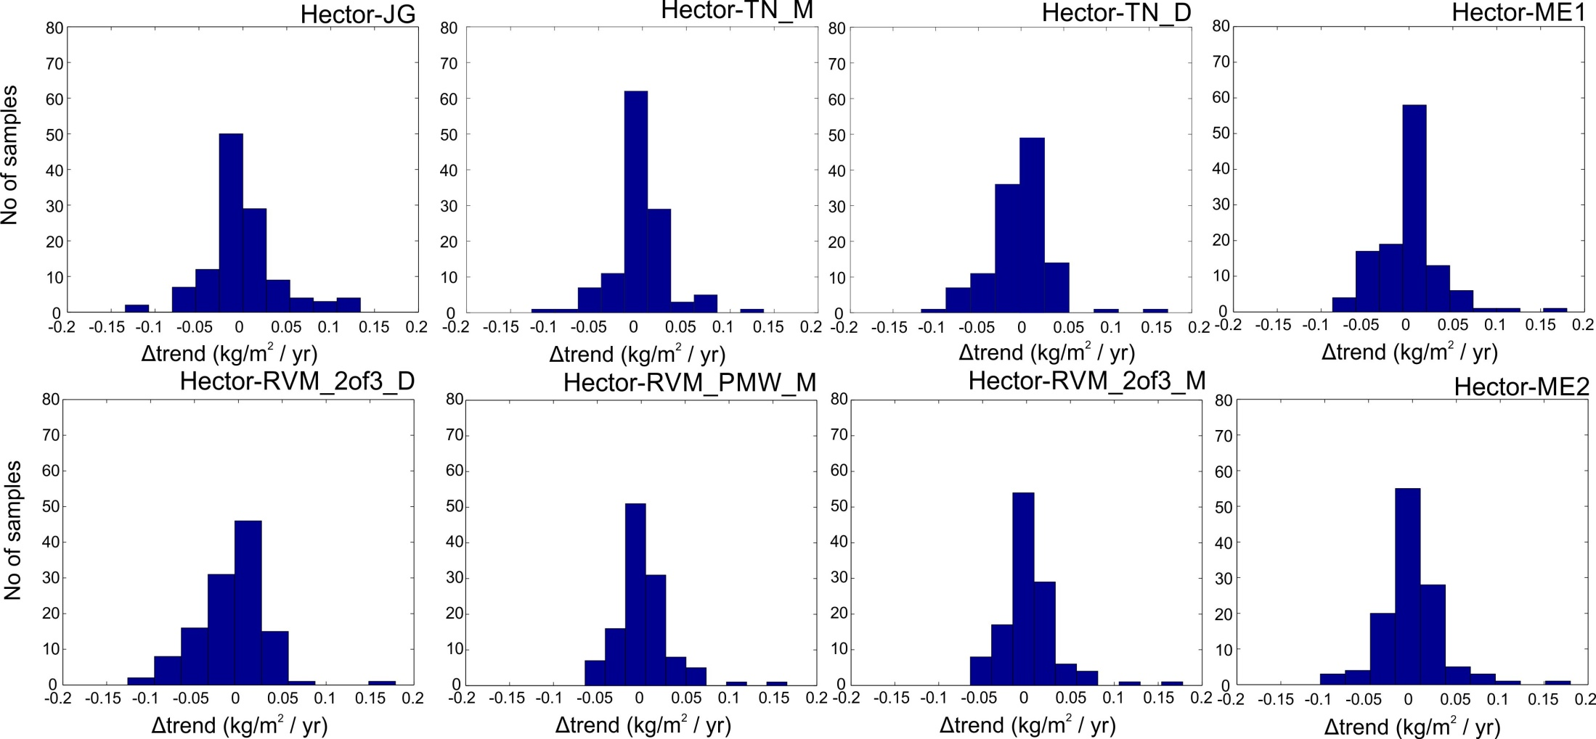
Motivation & introduction
Methodology
Synthetic datasets
Performance of homogen tools
Outlook
2. Trend estimation
FULLY COMPLICATED
“Hector “ = output from MLE with simulated offsets
most trends differ within ±0.05 mm/yr.

Slide 24
Motivation & introduction
Methodology
Synthetic datasets
Performance of homogen tools
Outlook
Workplan
more detailed assessment of the performance of the different tools (and sensitivity analysis): CRMSE, …
The epochs and amplitudes (and feedback) of the offsets in the synthetic datasets is given to the participants who already provided their solutions → fine-tuning of their tools
We highly welcome other contributions (tools, solutions) in our activity! Interested? Please contact me at roeland@meteo.be.
A next generation of a fully complicated synthetic dataset will be generated:
    fully complicated II?
    gaps decoupled from trend(s)?
    based on the difference of the synthetic IGS repro 1 minus the real ERA-interim?
A second round of blind homogenization on this next generation dataset(s) will end in September.

Slide 25
Motivation & introduction
Methodology
Synthetic datasets
Performance of homogen tools
Outlook
Outlook
application of the good performing tools on the IGS repro 1
define a common strategy to correct the IGS repro 1 dataset, based on criteria as (examples!):
    break points should be detected by a minimum of homogenization tools.
    break point should be present in the metadata file of the station.
    the amplitude of the offset should be above a certain limit.
    break points should be detected in other IWV differences time series (e.g. IGS minus NCEPNCAR reanalysis)
Thereafter, the focus will be on a GNSS IWV dataset centred above Europe, homogeneously reprocessed, with about 100 sites (out of 280) with data from 1996-2014 (→ neighbour-based approach possible?)
We are looking forward to getting feedback/input/participation from your community!

Slide 26
Thank you for your attention

Slide 27
breakpoints detected in metadata & visual inspection, but not by any of the groups?
breakpoints detected by a number (all) tools, but no metadata information?
time window! When are breakpoints coincident?

Slide 28
If significant frequencies were not accounted for, it may lead to wrong trend estimates.
Computations were performed with Maximum Likelihood Estimation (MLE) in the Hector software.

Slide 29
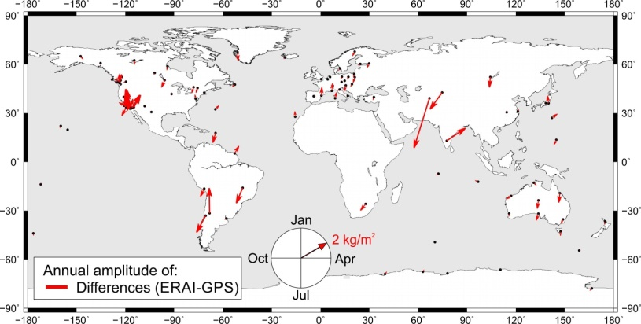
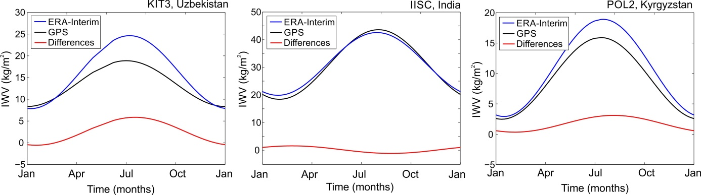
Characterization of real data:
Annual signal.
The largest differences between seasonal curves were found for KIT3, IISC and POL2 due to a shift in phase.

Slide 30
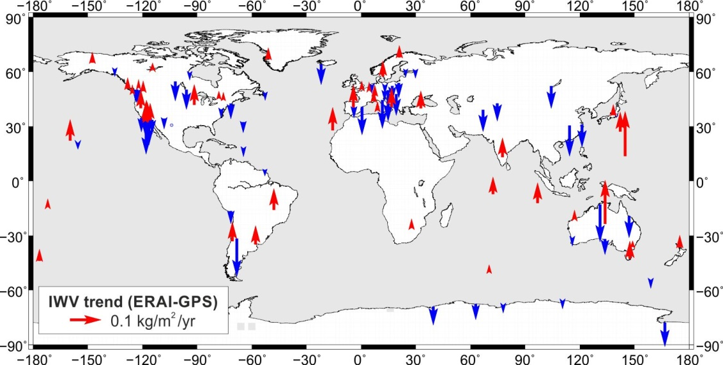

Slide 31
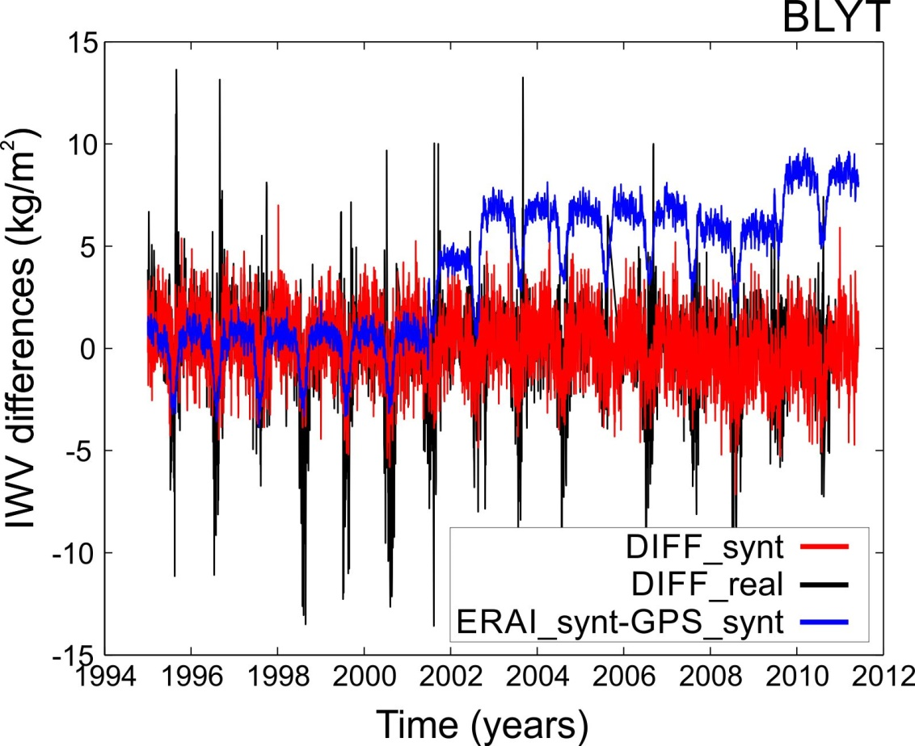
Why did we go for synthetic differences (DIFF_synt)?
We examined ERAI_synt-GPS_synt and we couldn’t have covered some part of power…
  There is remaining unmodelled “signals and noise” in the time series of the real differences.

